Slide 1

MELBOURNE HOUSE MARKET – Nontechnical Presentation
Mehmet Tiras – December 2020

Slide 2
Main Research Questions
1. Is Melbourne real estate market good for investment?
2. What is the best price range for profit?
2. What is the best location to invest?
4. What is the best property type (single, townhouse, or unit)?
5. Which room types is the best strategy for sales volume?
6. The best real estate companies to work with for quick sale
7. What are ideal distances to gain the best sales volume?

Slide 3
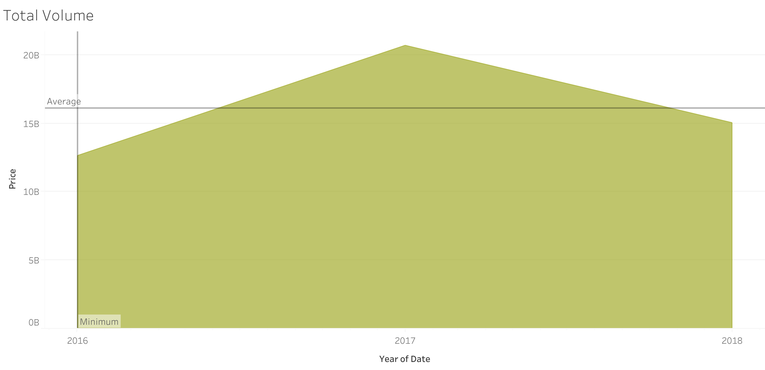
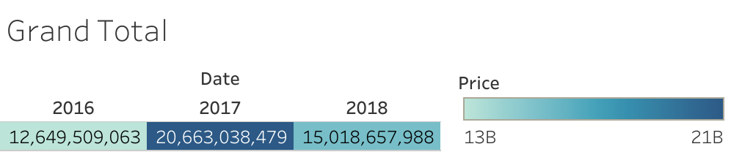
Melbourne House Market’s turn over is $48,331,205,530 total for three years (2016,2017,2018). The market can serve to gain the company’s strategic goals targeted profit of 2% in 2019.

Slide 4
These charts show the best strategy to reach a 2% return in 2019 in terms of sales volume, which will help to get an advantage of profitability.
Price Range (2016-17-18) Property Sold
0-$500,000 5512
$500,000 - 1,000,000 24990
$1,000,000 - 3,000,000 16623
> $3,000,000 608

Slide 5
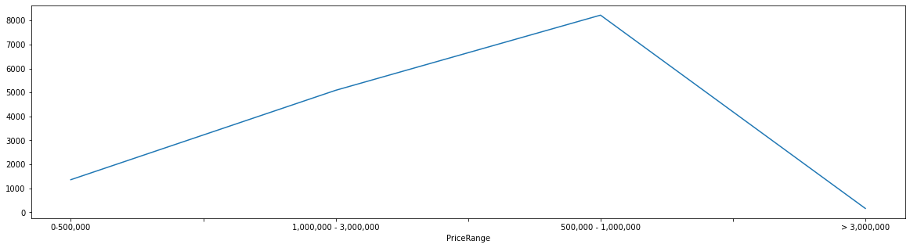
When we look at the 2018 price range, between $500,000 and $3,000,000 have the highest volume. The company should be focused on this area to make the planned profit.
Price Range - 2018
0-500,000 1360
1,000,000 - 3,000,000 5089
500,000 - 1,000,000 8224
> 3,000,000 161

Slide 6
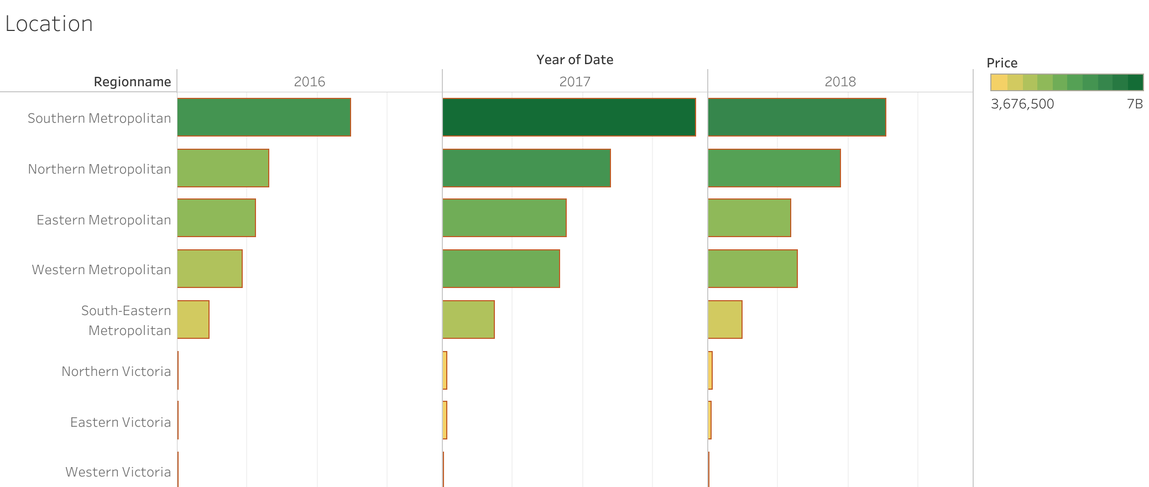
The best profitable zone is the southern part of the city concerning its high-volume capacity that Tableau shows.

Slide 7
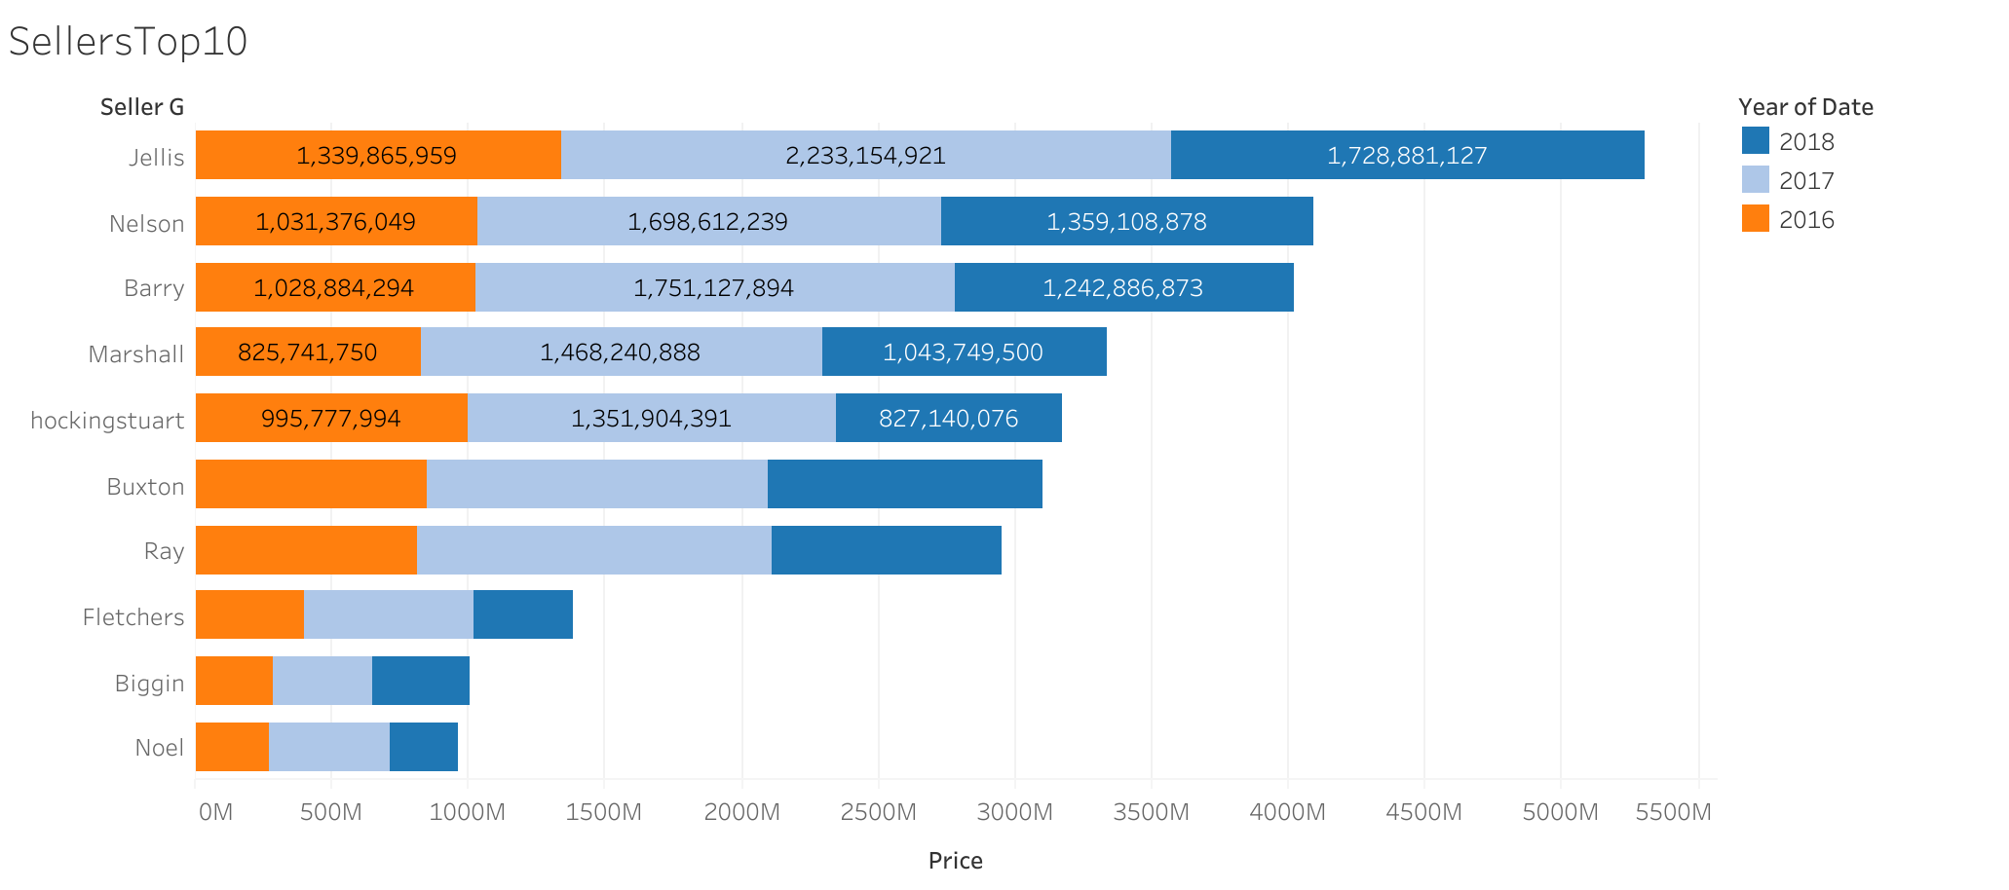
The Company can work with these Top10 real estate companies for the Melbourne market. These companies prove as trusted addresses in terms of their turnovers for three years.

Slide 8
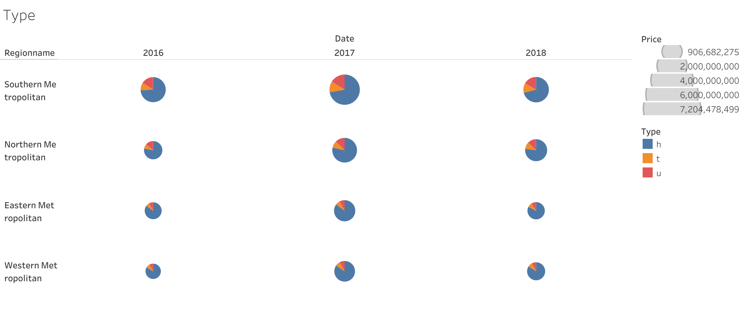
The type of single house dominates the market as the most desired one. Choosing “h” type properties serve the company's short- and long-term sales strategy.

Slide 9
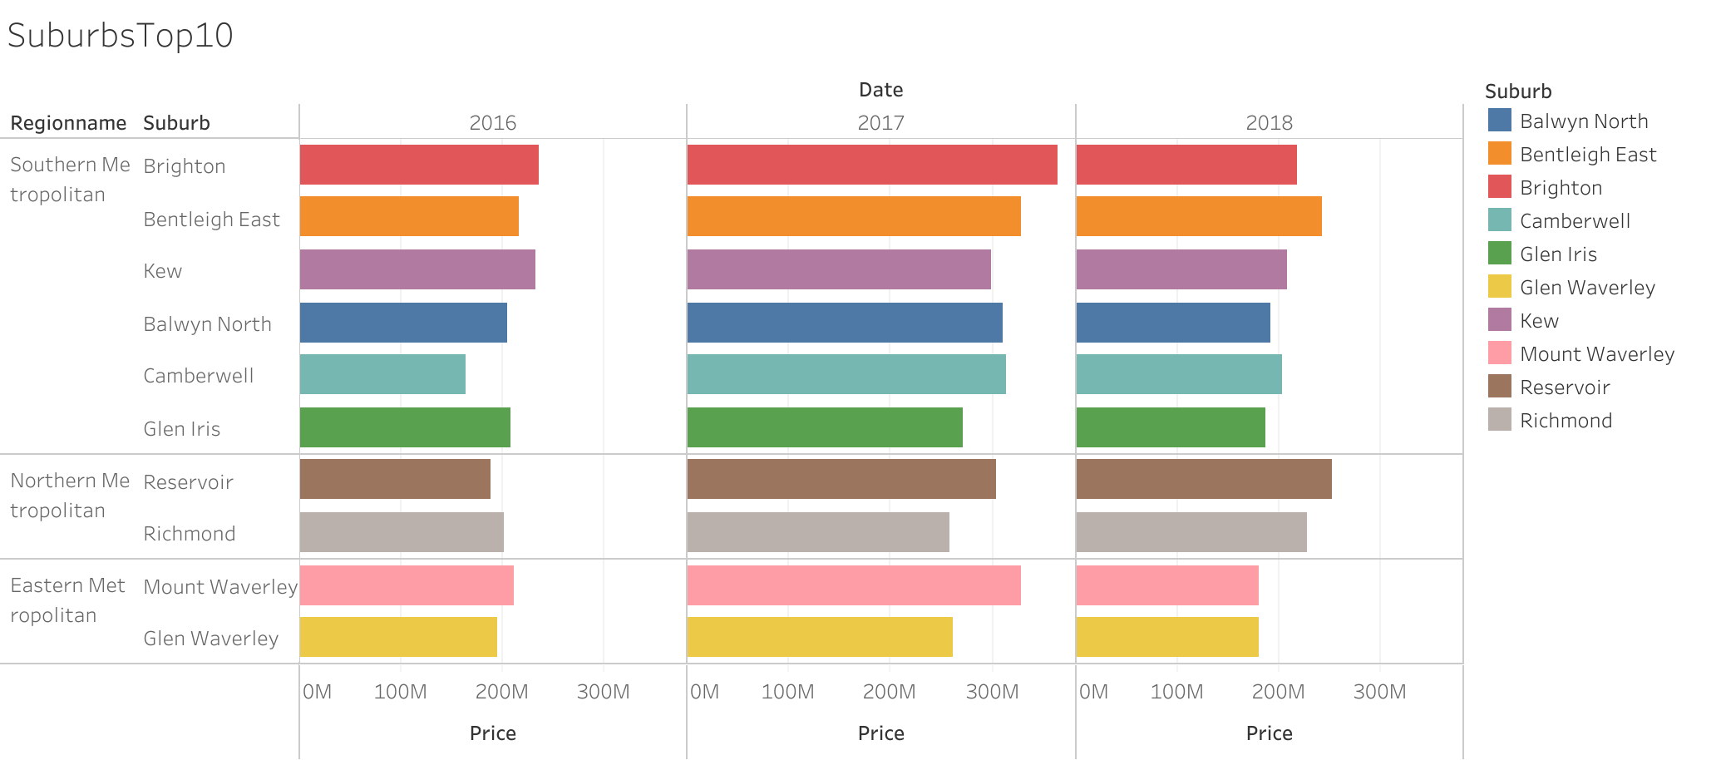
Southern suburbs dominate the Top10 list in terms of high-sales volume capacity. Sticking to these areas will secure the company’s target.

